Slide 1

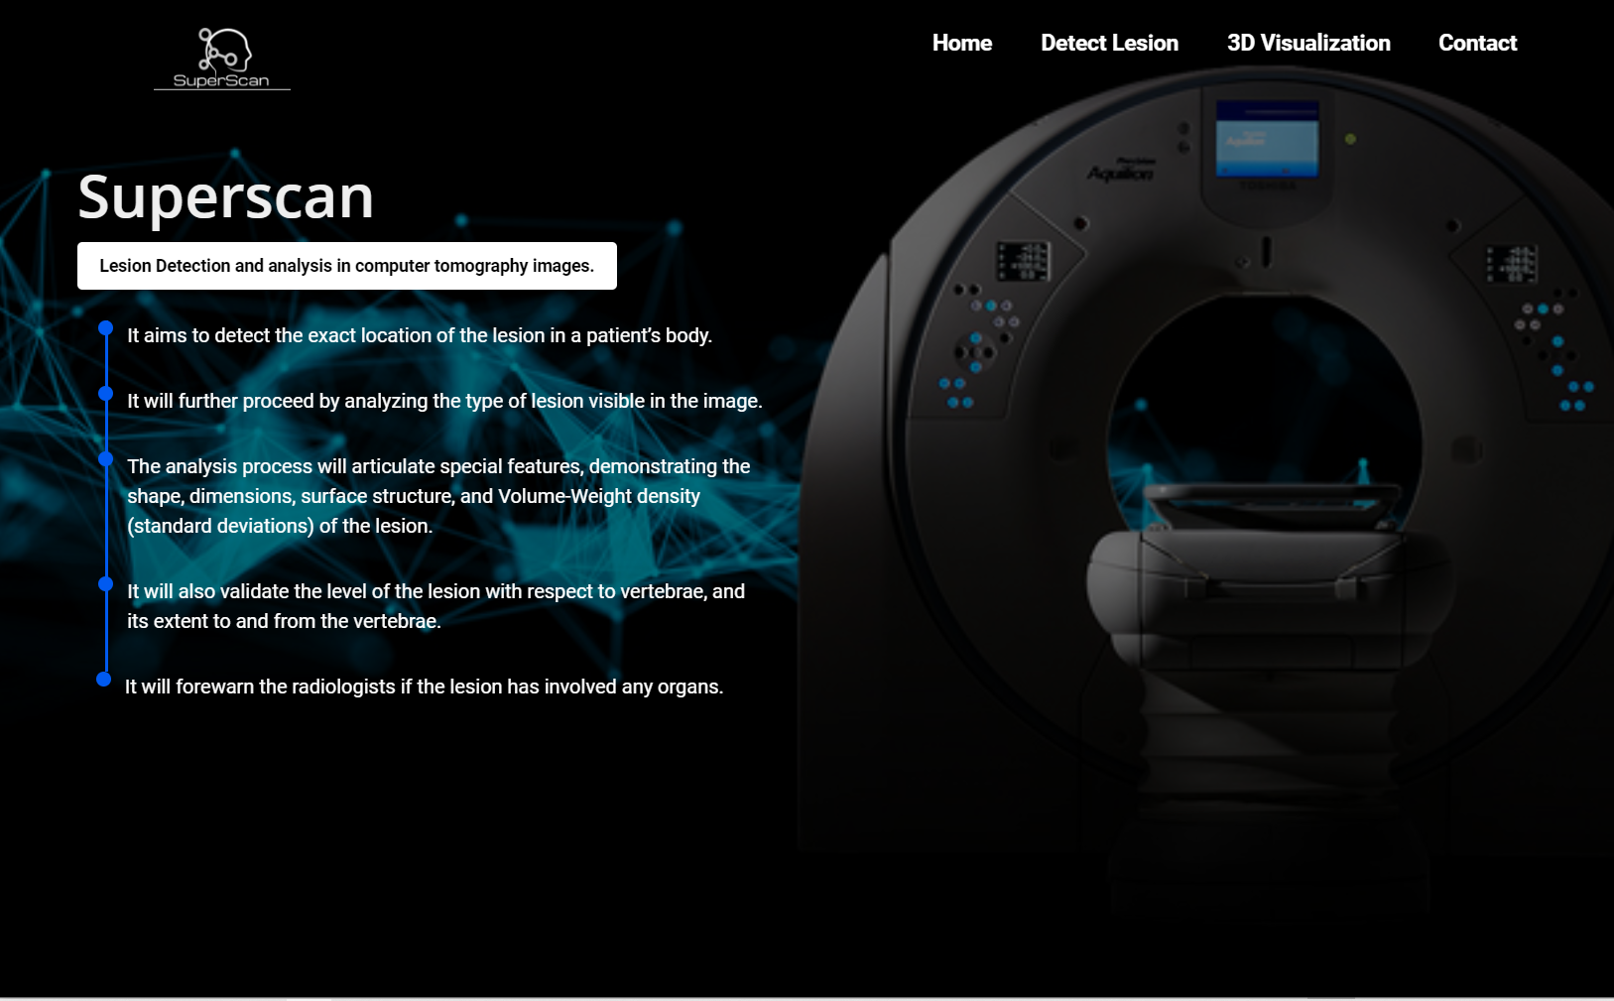
Lesion Detection and Analysis in CT Scan
FYP PROJECT Members
Slahuddin ch - 16I-0060 Abdul Masood - 16I-0312
Hajra khan - 16I-0326
Supervised By
DR. MUhammad Adnan TARIQ

Slide 2
Overview
Problem Statement
Time consuming analysis of a single CT scan image.
Inefficient utilization of CT Machine
Redundant analysis of similar cases by radiologist
Solution
Automatic lesion detection and analysis
The project does not intend to replace radiologists rather it makes their job easier and efficient.

Slide 3
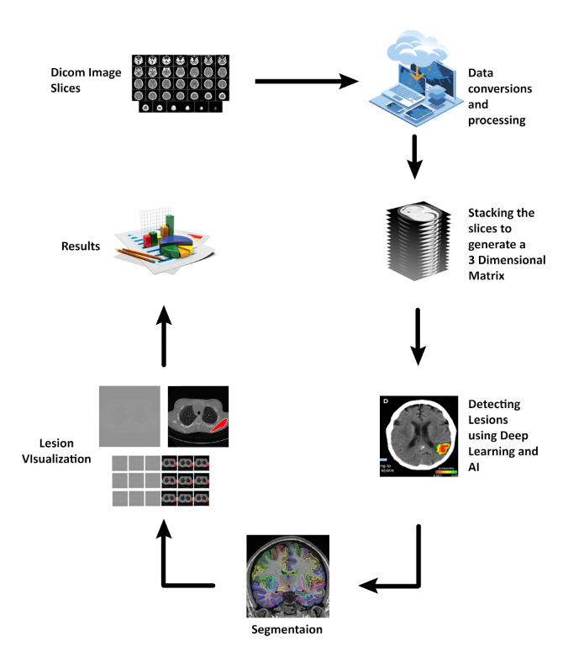
Project Process Flow Diagram

Slide 4
Timeline
Data Scraping
Sep’19
Model Training
Jan’20 – Feb’20
3D Visualization
Mar’20 – Apr’20
Data Preprocessing
Oct’19
Algorithm for Segmentation
Nov’19 – Dec ‘19

Slide 5
Work done since FYP-I Final Evaluation
Enhanced Image Dataset
Lesion Detection in Multiple Slices
Segmentation of Lesion
Model Fine Tuning
Improved Accuracy
Improved Mask Generation
Improved Frontend

Slide 6
Work to be done till FYP-II Final Evaluation
Iteration addition in frontend
Analysis of Lesion
- 3D Visualization (Optional)
- Organs involved (Optional)
Improve Mean IoU of trained model

Slide 7
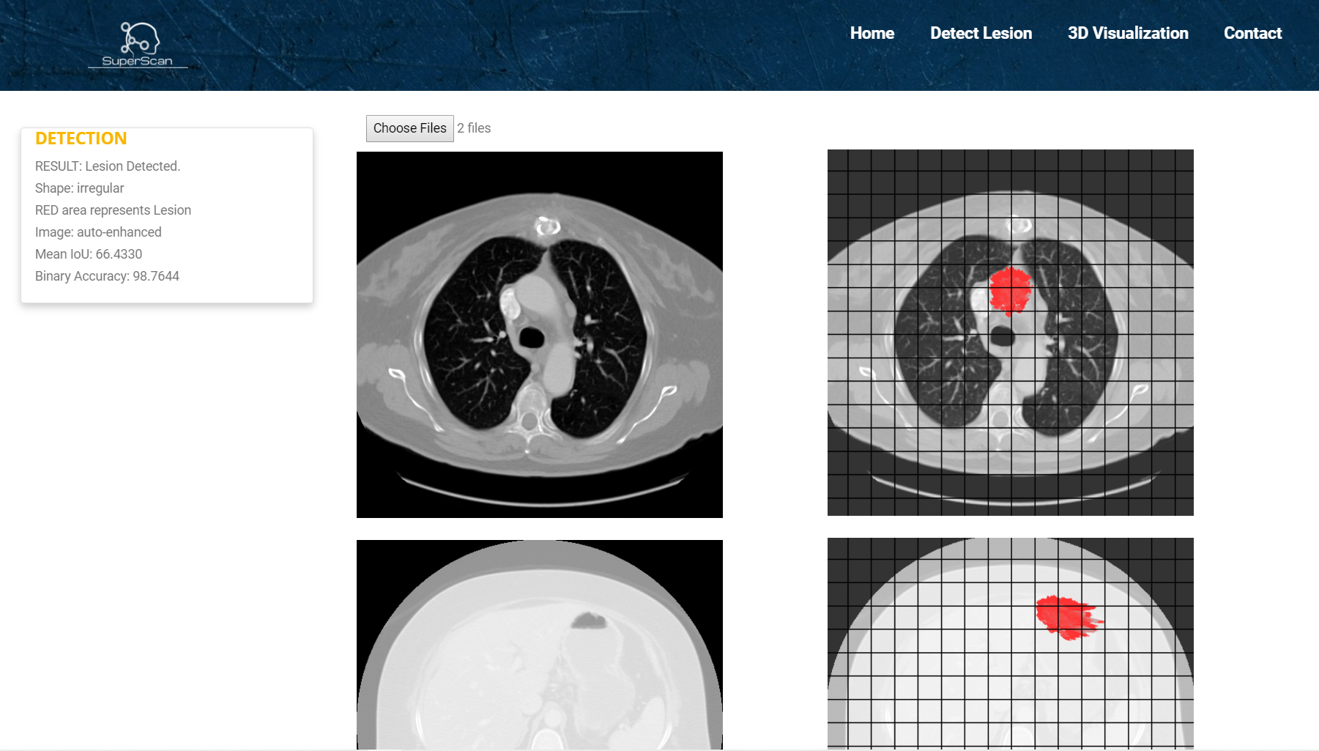
Application Snapshot

Slide 8
Implementation/Demonstration

Slide 9
Any Questions?

